Slide 1
Slope Stability Charts
CE 544 – BRIGHAM YOUNG UNIVERSITY

Slide 2
Chart Solutions
See Appendix in text
Can be used to solve for critical FS for a variety of simple problems
Simple and accurate solution for homogenous slopes, especially φ=0 conditions
Can be used as approximation for non-homogenous cases by averaging strengths and unit weights

Slide 3
φ=0 Charts
See Figures A-1, A-2, A-3, A-4 in text
Assumes homogenous conditions
Adjustments provided for:
Surcharge
Submergence
Tension crack (with or without water)

Slide 4

Parameters
$$d=\frac{D}{H}$$

Slide 5
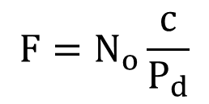
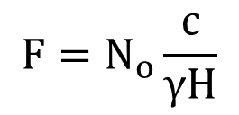
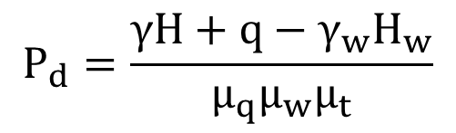
Equations
General Case:
$$F=N_{o}\frac{c}{P_{d}}$$
N_{o} comes from Figure A-1, pg 275
Adjustment factors μ_{q}, μ_{w}, and μ_{t} are associated with surcharge (q), submergence (H_{w}) and tension crack (H_{t}) and come from Figures A-2, A-3, A-4
$$P_{d}=\frac{γH+q−γ_{w}H_{w}}{μ_{q}μ_{w}μ_{t}}$$
Non-submerged slope, no adjustments:
$$F=N_{o}\frac{c}{γH}$$

Slide 6
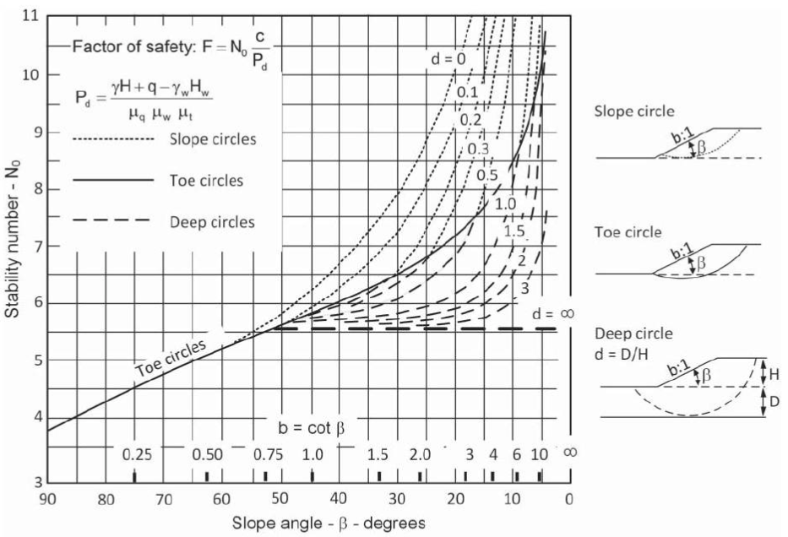

Slide 7
Location of Circles
Cotβ < ~0.6 (β > 60º)
Critical circle does not pass below elevation of toe of slope, regardless of the depth of the foundation
“Toe Circle”

Slide 8
Location of Circles
Cotβ > ~0.6 (β < 60º)
Presence of stronger materials prevents circle from penetrating below the base of the slope
Critical circle is tangent to base of slope and exit point is above the top of the slope.
“Slope Circle”

Slide 9
Location of Circles
0.6 < Cotβ < 0.75 (53º < β < 60º)
Presence of stronger materials at depth may affect outcome. See next slide.
Critical circle does not pass beyond the toe of the slope but may pass below the elevation of the toe.
“Toe Circle”

Slide 10
Location of Circles
0.75 < Cotβ < 1 (45º < β < 53º)
Critical circle may pass through the toe of the slope or to the bottom of the foundation.
There may be two circles with minimum FS.
“Toe Circle” or “Deep Circle”

Slide 11
Location of Circles
Cotβ > 1.0 (β < 45º)
Critical circle passes to bottom of foundation, regardless of depth
“Deep Circle”

Slide 12
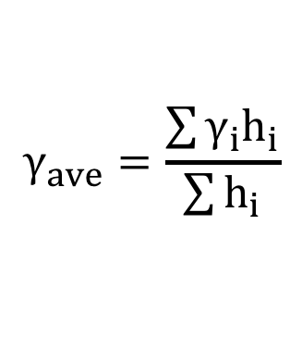
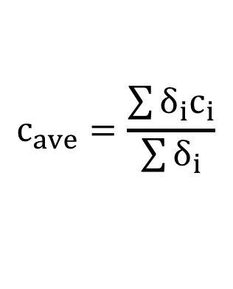
Multiple Materials
$$c_{ave}=\frac{\sum{δ_{i}c_{i}}}{\sum{δ_{i}}}$$
$$γ_{ave}=\frac{\sum{γ_{i}h_{i}}}{\sum{h_{i}}}$$

